Slide 1


Agriculture Initiative
Mission Pulses
Program in Uttarakhand
ENDLINE EVALUATION
Executive Summary
Perid: Feb- June, 2023
Assessment Period:
Feb- Dec, 2023

Slide 2




Program Coverage, Outlay and Focus Area
Project period: Feb 2018 - Jan 2023 (NCE upto Sep 23)
Enhance Incomes of 30,000 mountain farmers from 500 villages through production, technology, post harvest processes and collective marketing
Outlay (in Crores) | Budget | Expenditure | % Utilization
Trusts | 9.5 | 8.8 | 93%
Others | 15.5 | 15.3 | 98%
Community | 4.8 | 4.39 | 91%
Total | 29.9 | 28.5 | 94%
Uttarakhand Program (Mountain districts)
Coverage | Target | Achievement
State | 1 | 1
Districts | 9 | 9
Blocks | 12 | 12
Clusters | 12 | 12
Villages | 500 | 500
Households | 30000 | 29,869
Interventions/ Focus Area
Strengthening of Key Value Chains
Pulses, millets & traditional crops cereals
Mountain seed production
Himalayan honey
Herbs, spices and vegetables (high value)
Creating critical Irrigation support system
Popularize farm Mechanization & post harvest
Improved varieties & production technology
Community institution led value addition, storage, market linkage development
97%
Field Implementing Partners : – CHIRAG, KSS, Himad Samiti, DI -9 clusters
Donors:
Notes:
50 population dependent of agriculture, in mountain 90% does agriculture and it is main stay of their livelihoods. But the area of agriculture is declining. Over the last 20 years (after the formation of state) more than 70 thousand hectare are was converted for non-agriculture purpose.

Slide 3
Theory of change
The key activities, outputs and outcomes of the program were as follows –
Activities | Key Outputs | Outcomes | Impact
2,850 acres farm under improved technologies and management practices. 2,450 quintals seed produced and marketed. 1 agri processing unit was established. 2 custom hiring centres 200 farm machines to farmers/ groups. Irrigation infrastructures including 10 numbers of solar lift were established. 6,000 kgs of honey marketing. 3,000 farmers under organic production 12 CFC | Six cluster pulses production cluster Six cluster as high value crops 12 Women Farmers Cooperatives 50 local youth as agriculture extension workers/ entrepreneurs - earn at least Rs. 100,000/- year. 22,960 farmers trained | Pulses productivity - 1.25 to 2 times (20,000 farmers) Brand ‘Trishulii’ established for agriculture commodities. Established supply chain of mountain agriculture commodities in 12 clusters. 6,300 qtl of agri- produce marketing -SRCs and Trishulii- annual turnover Rs. 2.5 crore. increase in production of pulses -800 kg/ ha to 1,600 kg/ ha. 20% reduction in losses due to improved post-harvest processes | Income levels are expected to increase by Rs. 50,000/- to Rs. 70,000/- per year from various sources Rs. 20,000/- / year / household, from pulses 12 CFC economically viable. 12 FPOs and Trishulii economically viable through collective branding and marketing.

Slide 4
Methodology
Primary and secondary research techniques
Methodology
Study processes
Primary Research
Secondary Research
Rollout meeting and desk study
Visit to Himmotthan Society office and relevant locations
Development and finalization of study tools
Development of data collection software, testing, and finalization
Field teams' orientation/ training
Field testing of survey instruments
Data collection
Quality management protocols
Quantitative
Qualitative
Household level surveys with 527 respondents (estimated at 95% confidence interval and 3.5% margin of error).
Cumulative sample count - 905,
Survey done using CAPI method.
Focus Group Discussion at community institution/SRC level (8)
FGD - CFC level (2)
FGD - Trishulii level (1)
FGD - farmers (12)
In-depth Interview - Lakhpati Kisan (6)
Key Informant Interview (Tech partner)- (2)
Literature review
Study of all the data / information/ report Himmotthan i.e., project briefs,
baseline report,
Data and other documents.

Slide 5

Findings
02
Ganeshpur, Bhatwari & Jaripani: farmers started cultivating chilli, ginger, garlic, coriander, turmeric and onion commercially, while continuing to cultivate wheat and rice in a reduced area.
03
Chaukhutiya: farmers began using improved basmati variety “Pusa basmati 1718” and fine gain paddy PR 126
in place of the local variety China 4. Likewise, in the case of wheat, the local varieties were substituted with WH 1105 which is rich in iron.
Adoption of new crops and improved seed varieties
01
Walthi, Chaukhutiya & Kotabagh: farmers continued cultivating traditional crops along with new ones.
54%) farmers introduced new varieties of crops in their fields.
04
Local onion replaced by VL Piyaz 3
06
Uttarkashi: farmers introduced improved fodder varieties like napier grass (intercropped with wheat) and berseem (harvested multiple times, ensuring continuous supply of fodder). Milk production increased after farmers started feeding the animals napier grass and berseem.
05
Kapkot: Local millets replaced with VLM 352 & VLM 380 (finger millet) and VLM 207 & PRJ 1 (barnyard millet)

Slide 6
Productivity Enhancement – Pulses
Pulses>> | Rajma (kidney Bean) |  | Black gram (chana) |  | Black Soyabean |  | Tur (pigeon pea)
 | Pre-project | Post- project | Pre-project | Post- project | Pre-project | Post- project | Pre-project | Post- project
Avg. sowing area per HH (in nali*) | 2.9 | 3.5 | 2.7 | 4.1 | 4.2 | 4.6 | 1.9 | 1.5
Yield (per acre)* Qtl | 5.8 | 10.4 | 6.6 | 6.4 | 7.0 | 13.6 | 1.0 | 2.4
Change in yield over baseline (+/-) | -- | +79.3% | -- | -3.0% | -- | +94.2% | -- | +140.0%
Net income (per acre) | 11,436 | 80,694 | 14,528 | 24,972 | 18,820 | 75,826 | 1904 | 9,906
Kidney bean: 79% yield increase & six-fold profitability increase
Black soybean: 94% yield increase & three-fold profit increase
Pigeon pea: >100% yield increase & five-fold profit increase
Black gram: >72% increase in farmer profits
Marketing support from FPOs, adoption PoPs led cost reduction and played significant role in boosting profitability

Slide 7
Productivity Enhancement – Millets
*National av. -finer millets is 6.3 qtl/ acre while state av. - 5.6 qtl/ acre
Millets >> | Finger millet |  | Amaranthus
 | Pre-project | Post- project | Pre-project | Post- project
Avg. sowing area per HH (in acre) | 2.4 | 2.3 | 1.0 | 1.0
Yield (per acre) Qtl | 4.2 | 6.6* | 5.4 | 8.8
Change in yield over baseline (+/-) | -- | +57.0% | -- | +62.9%
Net income (per acre) | 1076 | 5686 | 2300 | 26350
Finger millets, Banyard millets, and Amaranthus
Significant increased in yields and net income
Varietal replacement
No use chemical fertilizers
When we were selling madua at the local markets before Himmotthan’s intervention, we were getting only Rs 18-20/kg. Now we are selling our produce to Trishulii through SRC which fetches a rate of Rs 25-30/kg”
– FGD Participant, Kapkot

Slide 8
Productivity Enhancement – Cereals Crops
*National & state av. rice is 10.6 & 10.4 qtl/ acre wheat is 13.7 and 11.5
Cereals >> | Red rice |  | Basmati |  | Wheat
 | Pre-project | Post- project | Pre-project | Post- project | Pre-project | Post- project
Avg. sowing area per HH (in acre) | 6.5 | 6.6 | 3.8 | 5.1 | 6.4 | 6.8
Yield (per acre) Qtl | 11.0 | 15.0 | 12.6 | 16.4 | 11.8 | 15.6
Change in yield over baseline (+/-) | -- | +36.3% | -- | +30.2% | -- | +32.2%
Net income (per acre) | 10460 | 22846 | 3552 | 10070 | 1724 | 4112
Productivity:
Improved varieties, seed treatment, IPM practices & timely harvesting contributed to these increases.
Improved seeds helped overcome challenges such as yellowing leaves and low yields.
“Last year, I cultivated the variety ‘Basmati 1718’ in 4 nali land. I got a yield of 4 to 5 quintals from the 4 Nali land. I also cultivated wheat and sold 2-3qtl seeds of wheat to SRC at Rs.20 per Kg. Both the rice and wheat seeds provided by Himmotthan gave higher productivity. After adopting the raised bed method of sowing, it has become easier to irrigate the crop and spray pesticides. Another benefit of line sowing is the seed requirement is much lesser as compared to broadcasting method
– FGD Participant, Chaukhutiya

Slide 9
Productivity Enhancement – Spices
Spices >> | Coriander |  | Ginger |  | Garlic
 | Pre-project | Post- project | Pre-project | Post- project | Pre-project | Post- project
Avg. sowing area per HH (in acre) | 1.5 | 1.9 | 2.5 | 2.3 | 0.7 | 0.7
Yield (per acre) Qtl | 2.2 | 2.8 | 12.0 | 15.4 | 19.6 | 25.8
Change in yield over baseline (+/-) | -- | +27.7% | -- | +28.3% | -- | +31.6%
Net income (per acre) | 5076 | 17094 | 75270 | 155554 | 73472 | 174312
Challenges Faced:
Distant markets force farmers to sell to traders or local shopkeepers, resulting in lower profit margins for farmers.
High disease and pest infestation leads to drying of the plants, affecting the yield and quality.
Solutions:
To address the pest management need for profitability and sustainability in the region.
Collaborative efforts from organizations, government bodies, and farmers for effective marketing
Continued support and training are crucial

Slide 10
Productivity Enhancement – Vegetables
Vegetables >> | Onion |  | Potato |  | Peas
 | Pre-project | Post- project | Pre-project | Post- project | Pre-project | Post- project
Avg. sowing area per HH (in acre) | 2.0 | 2.3 | 4.3 | 3.8 | 5.2 | 5.4
Yield (per acre) Qtl | 50.6 | 82.0 | 59.0 | 81.0 | 13.8 | 21.2
Change in yield over baseline (+/-) | -- | +62.0% |  | +37.2% | -- | +53.6%
Net income (per acre) | 49494 | 141356 | 37340 | 69802 | -9096 | 16928
Productivity and income: significantly increased for all crops, particularly onion.
Farmers adopted line sowing, & improved PoPs
Potatoes grown on ridges & furrows, reduced seed requirement & improved drainage, which helped combat pest infestation.
Polyhouse cultivation reduced crop cycle by 20 days compared to open-field
Farmers through cooperative Himvikas, receiving better prices than local market.
Farmers expressed concerns about irrigation, extreme cold weather affecting pea crops, & pest attacks

Slide 11
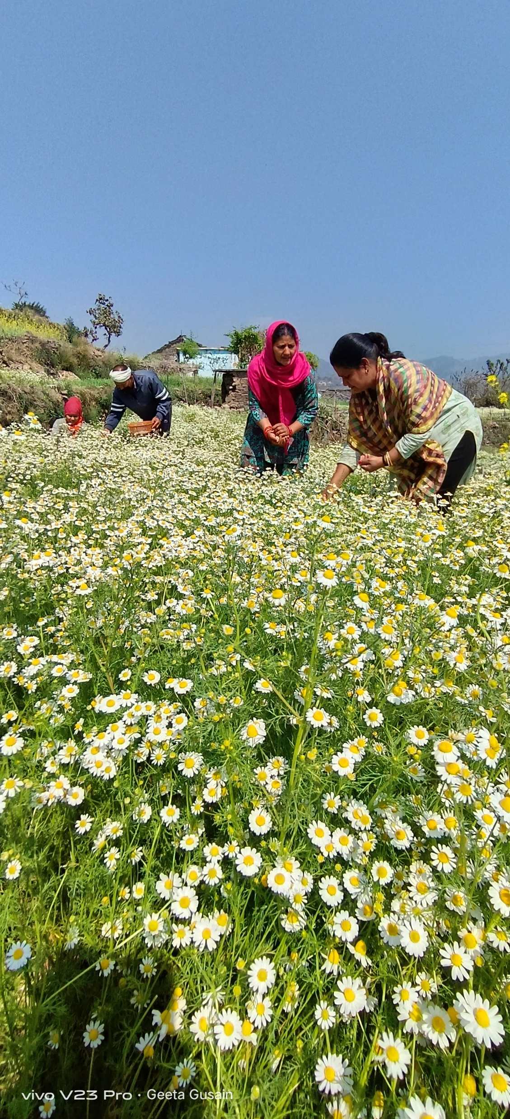
Productivity Enhancement – Aromatic Herbs
Herbs> | Rosemary | Chamomile
Avg. sowing area per HH (in acre) | 2.2 | 2.2
Yield (per acre) Qtl | 2 | 1
Net income (per acre) | 30,620 | 40,704
First time introduced Rosemary and Chamomile in Dugadda
Overall coverage: ……farmers -------area
Chamomile was preferred over Rosemary due to its higher profitability & more suitable soil conditions
The price of Chamomile was Rs. 600/kg, while Rosemary was priced at Rs. 200/kg

Slide 12
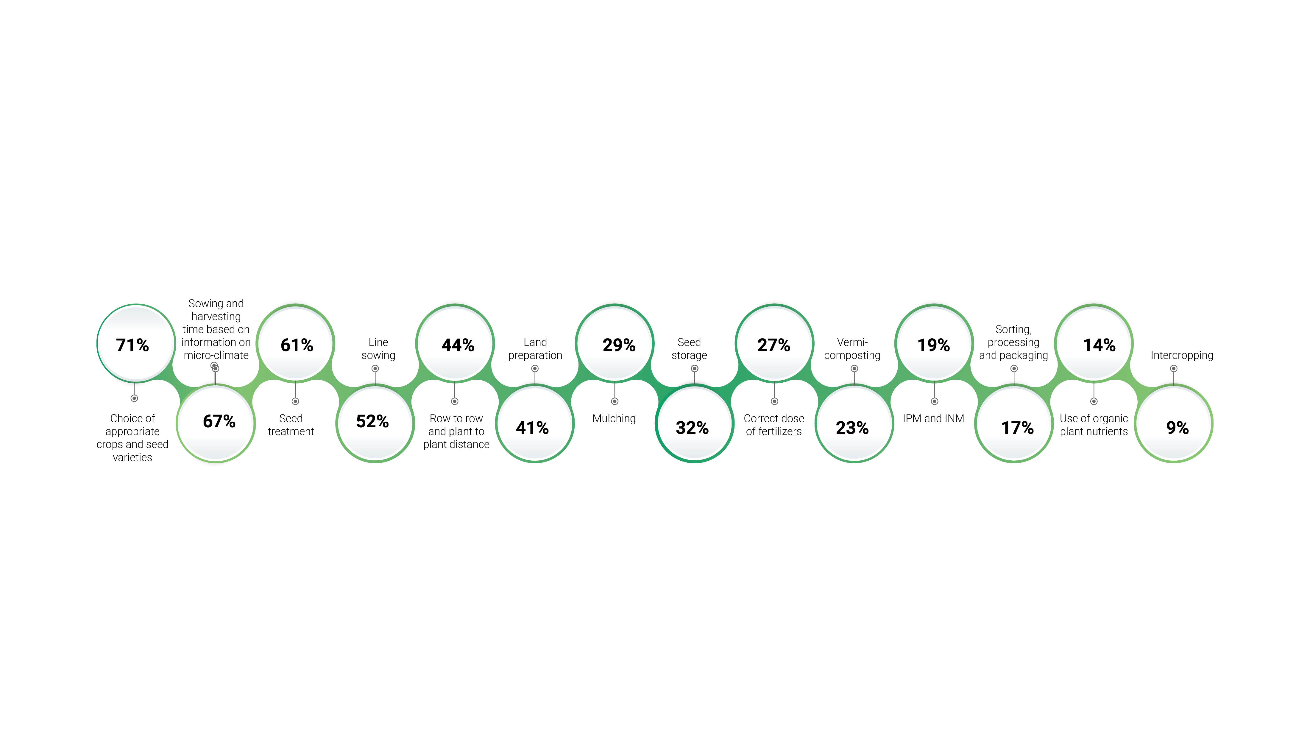
Knowledge and adoption of correct package of practices
All vegetables farmers adopted line sowing.
Farmers identified benefits of line sowing, such as time savings and reduced labor.
Some participants didn't remove weeds from their fields due to a lack of awareness about its negative impact on crop growth.
Field days & practical demonstrations witnessed farmers realized the advantages of adopting improved techniques, resulting in increased yields.

Slide 13
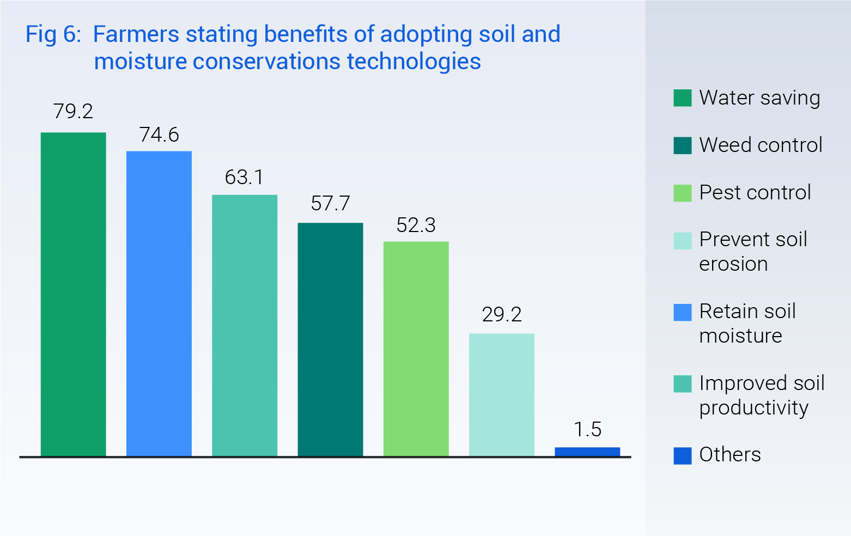
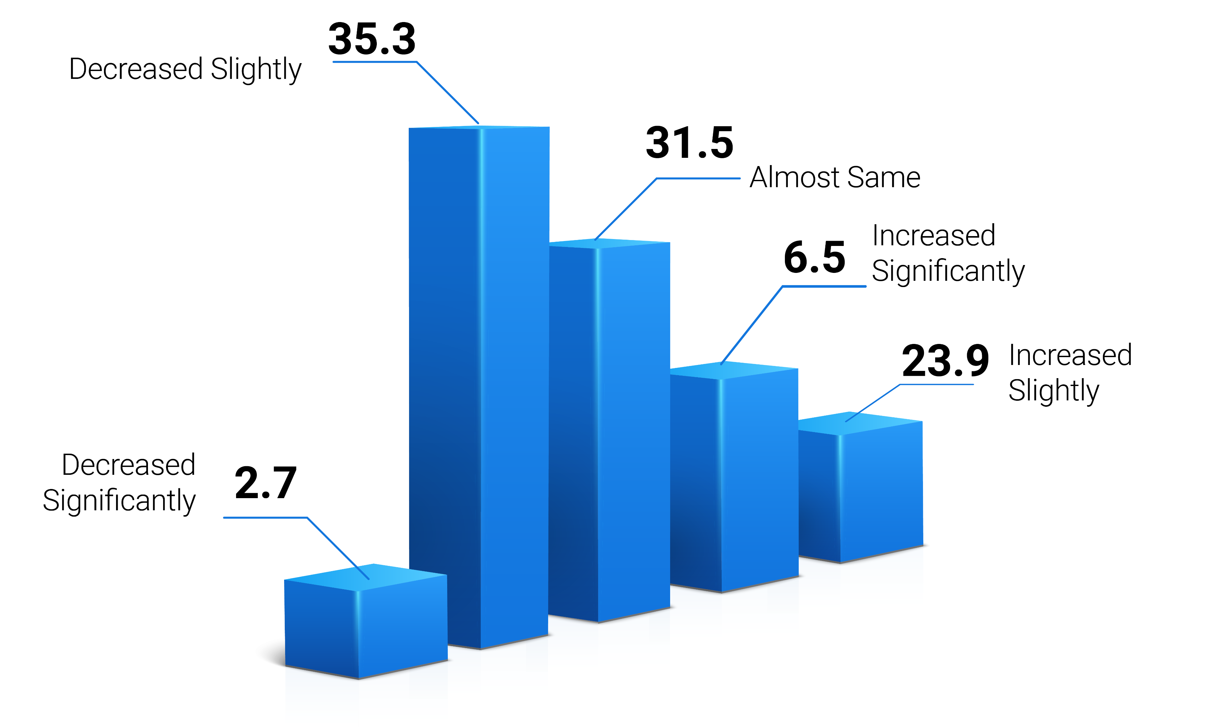
Reduced usage of chemical fertilisers
Adoption of Soil and Moisture conservation technologies
Percentage of farmers stating changed pattern with regard to usage of chemical fertilisers in the last 3 years
Farmers stating benefits of adopting soil and moisture conservations technologies
Farmers switched to the raised bed method for sowing onions and potatoes after Himmotthan's intervention

Slide 14
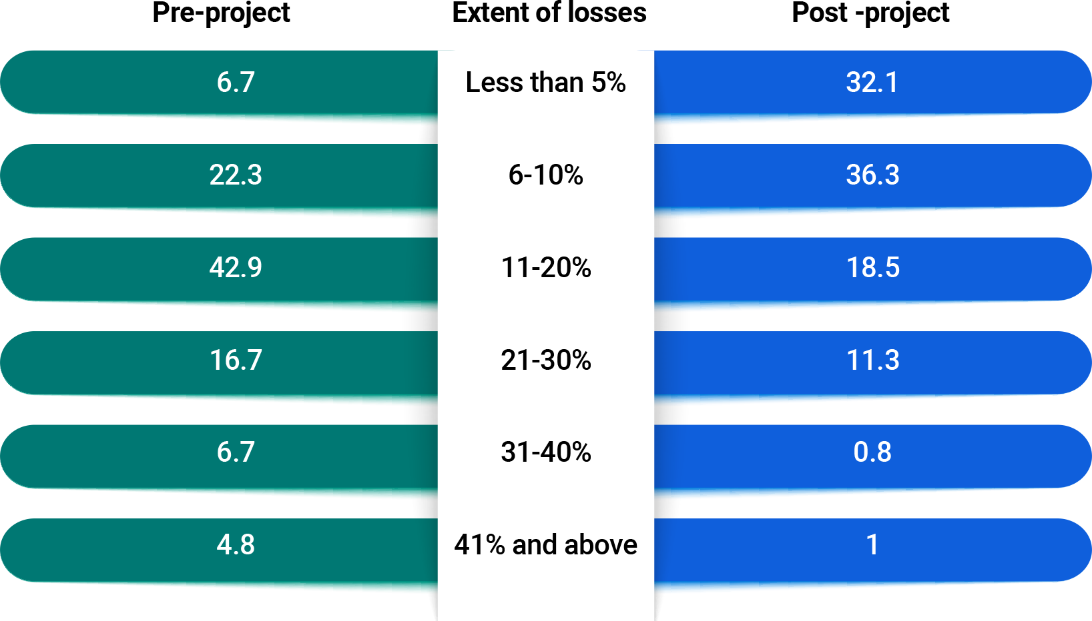
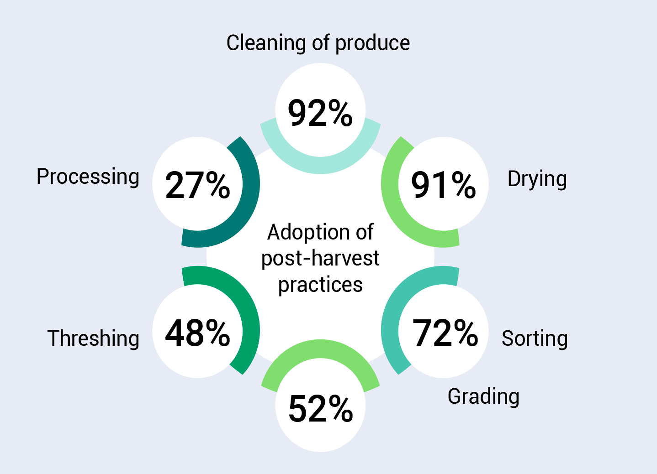
Post-harvest Management Practices
Adoption of post-harvest practices (%HH)
Reduction in post-harvest losses
43% HHS encountered losses ranging from 11-20% which is decreased to 19%.
Before the interventions, 23% HHs reported losses between 21-40%. After the interventions, only 7% HHS faced losses in this range.

Slide 15
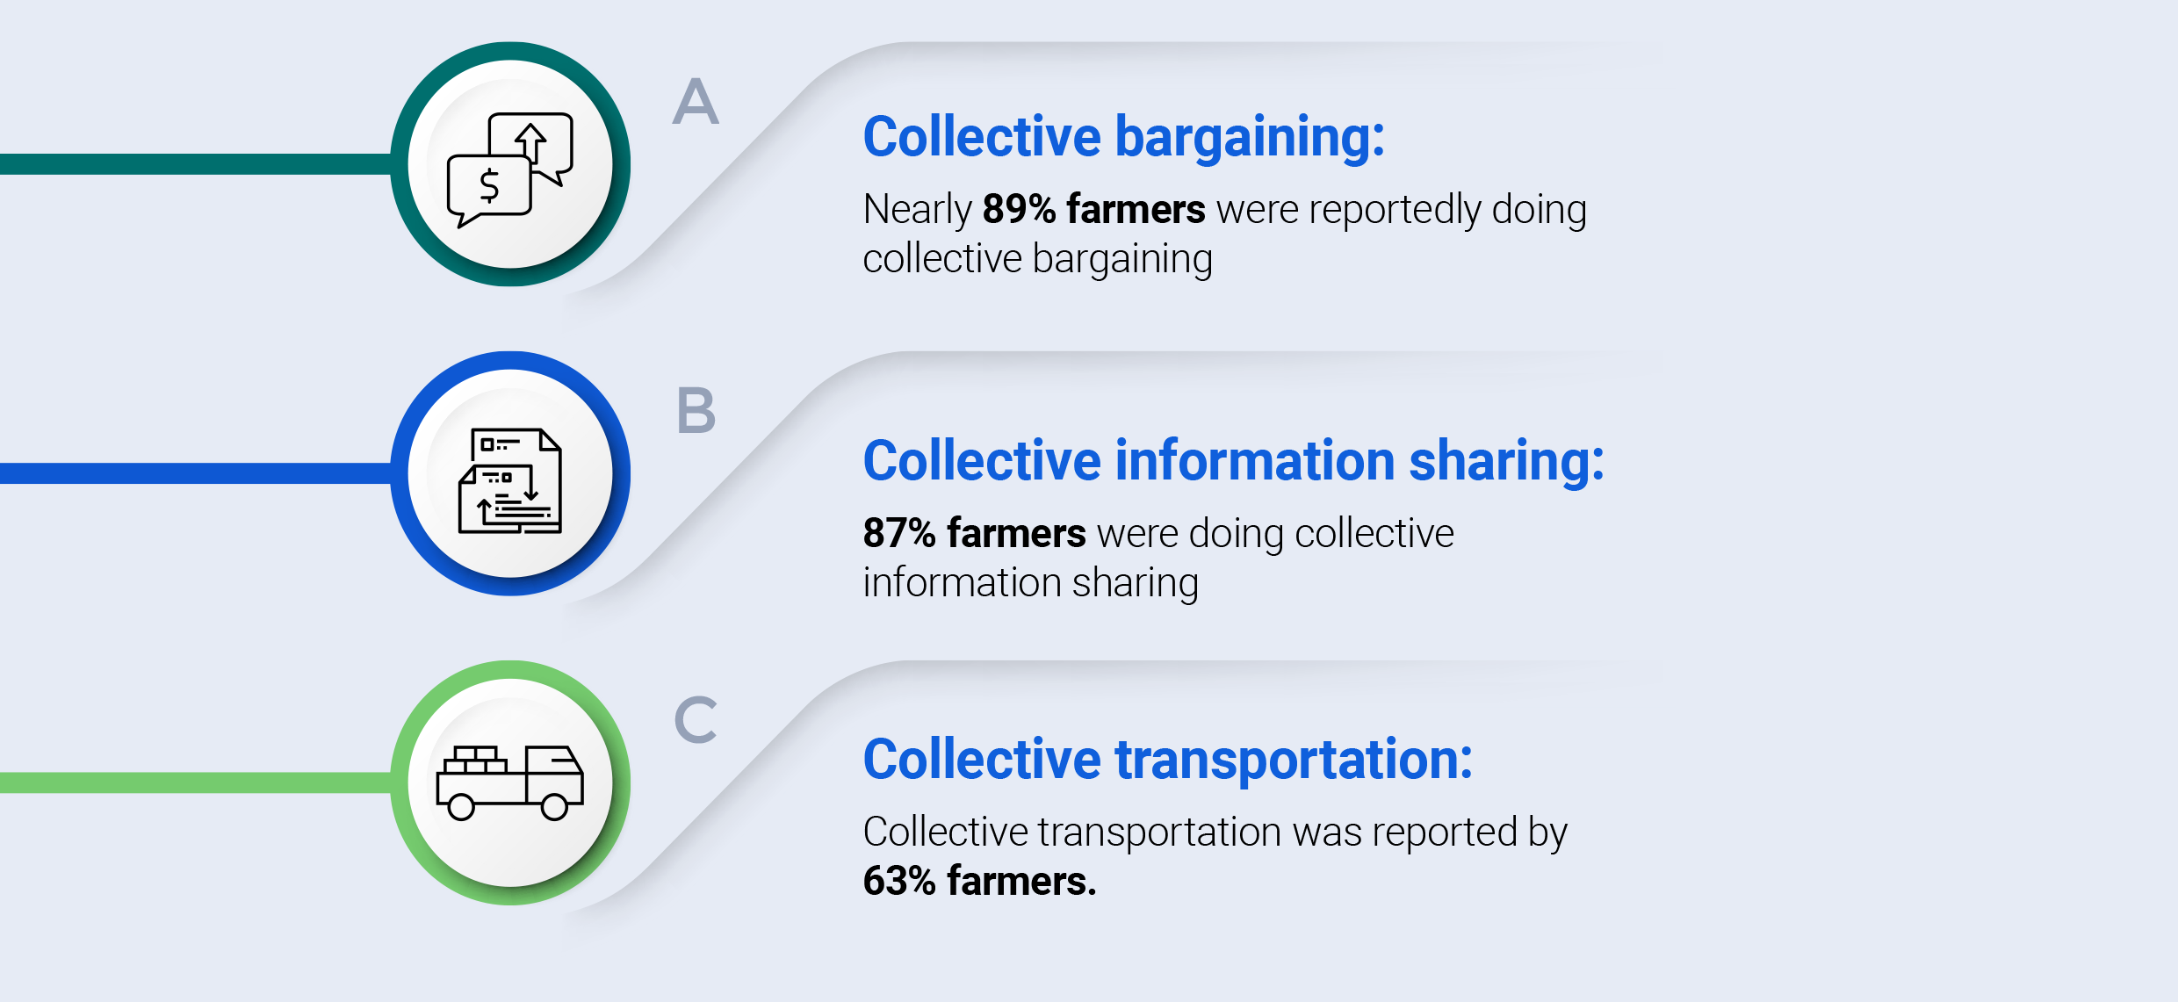
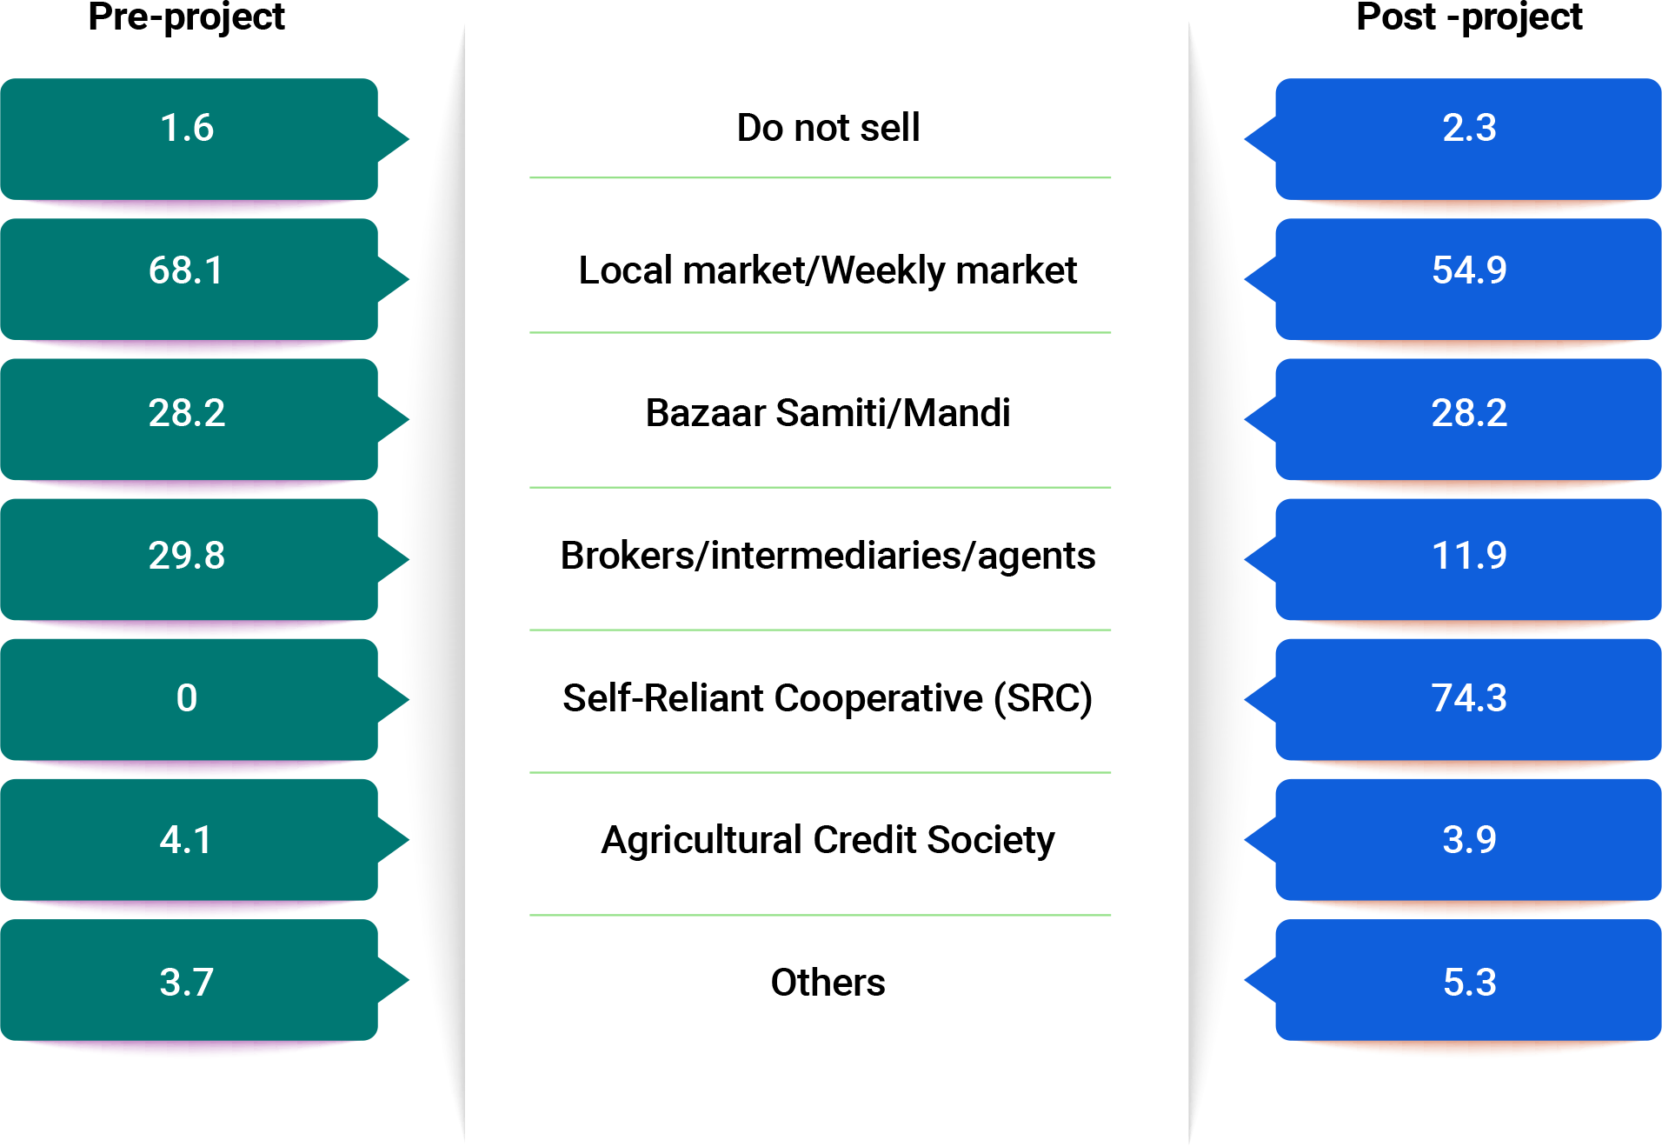
Post-harvest Management Practices
Change in marketing of produce
Multiple responses allowed
Most farmers now selling directly to the SRC, which offers better prices compared to the market rates.
Many women still rely on Himmotthan staff for assistance
Intensive support and capacity building are needed to empower collective members to function independently & sustainably

Slide 16
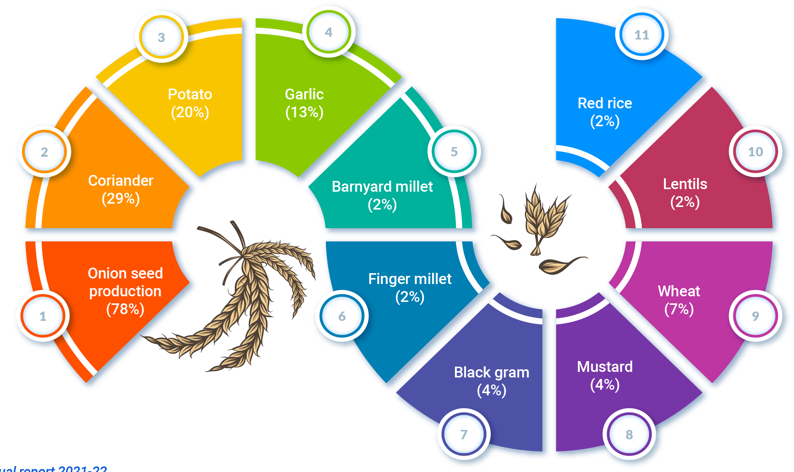
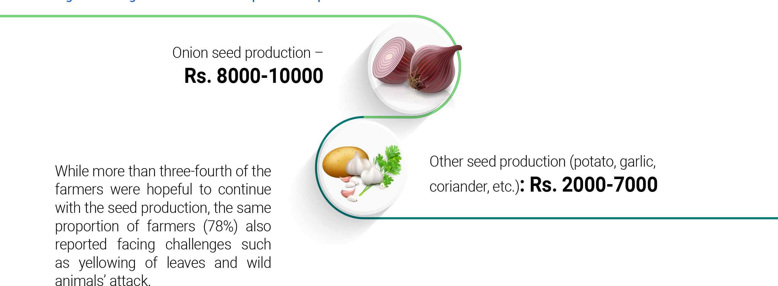
Seed production value chain
Type of seeds production
81% farmers reported changes in yield due to seed production
Farmers were hopeful to continue seed production, but challenges pest and wild animal attacks were reported by a significant proportion of farmers.
3750 farmers are engaged

Slide 17
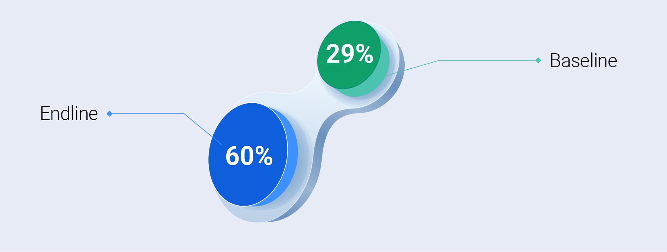
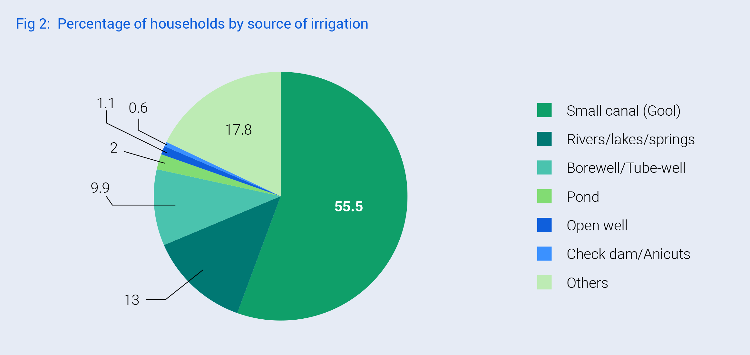
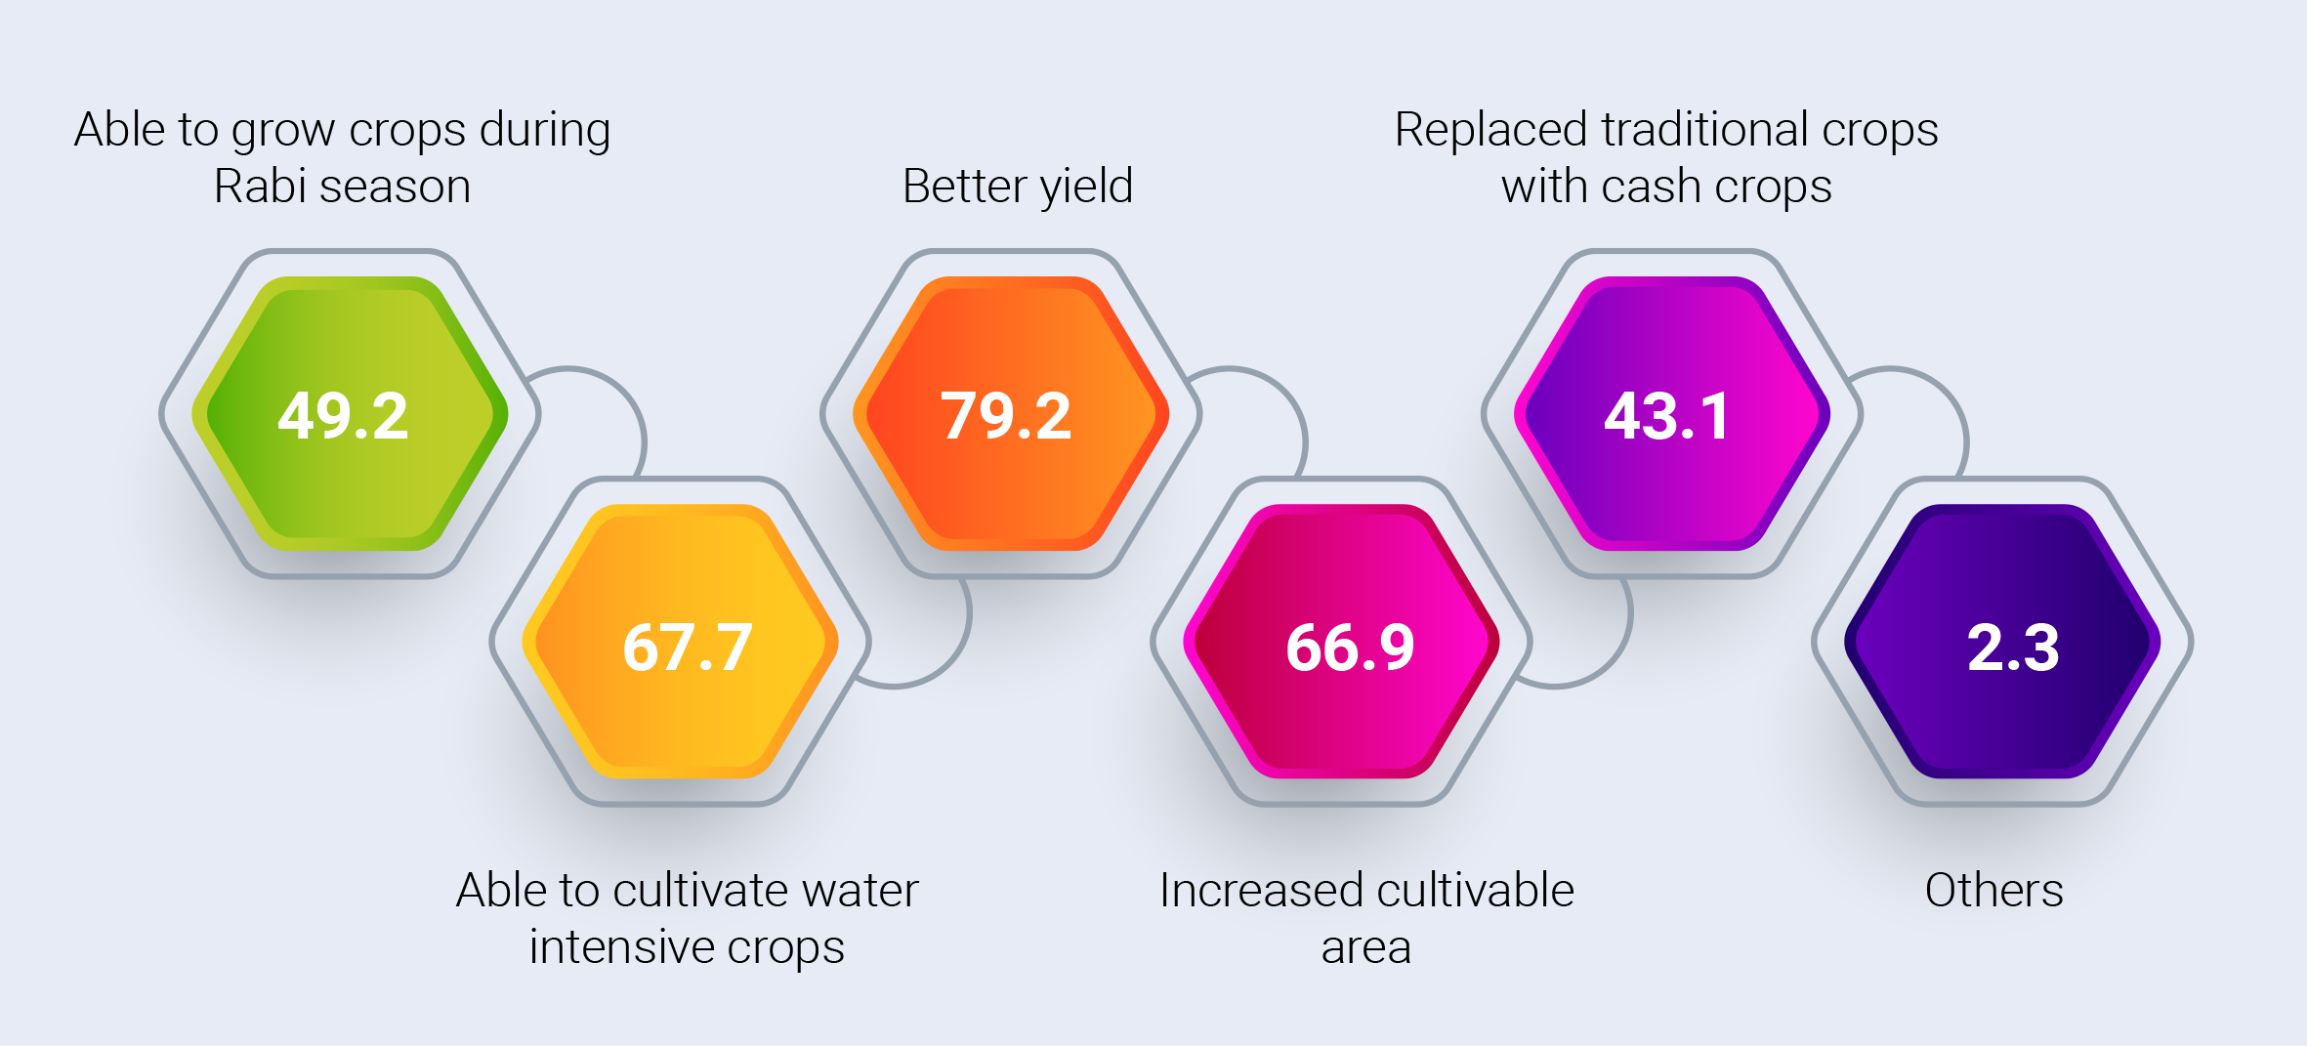
Land & Irrigation
99% HHS having own land
Av. landholding 0.8 acre (baseline -0.7 acre)
Irrigated land increased baseline (29%) to endline (60%)
Benefits & Impact (% HHs)
Irrigation source (Others): like gravity pipelines, rainwater, LDP tanks, solar pumping, etc. accounting - 18% HH

Slide 18
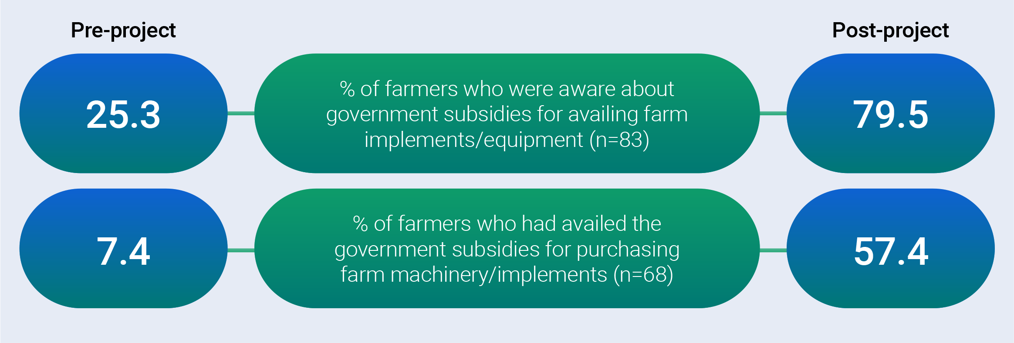
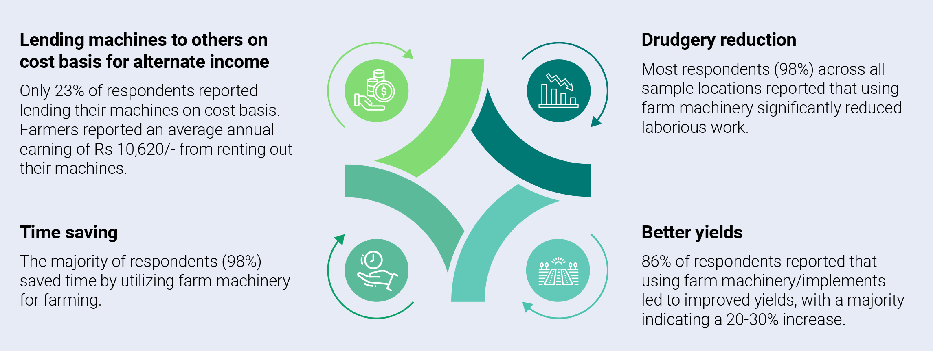
Farm Mechanisation
Change in awareness & availing farm implements/equipment through govt subsidies (% HHs)
Benefits and impact of using farm equipment

Slide 19
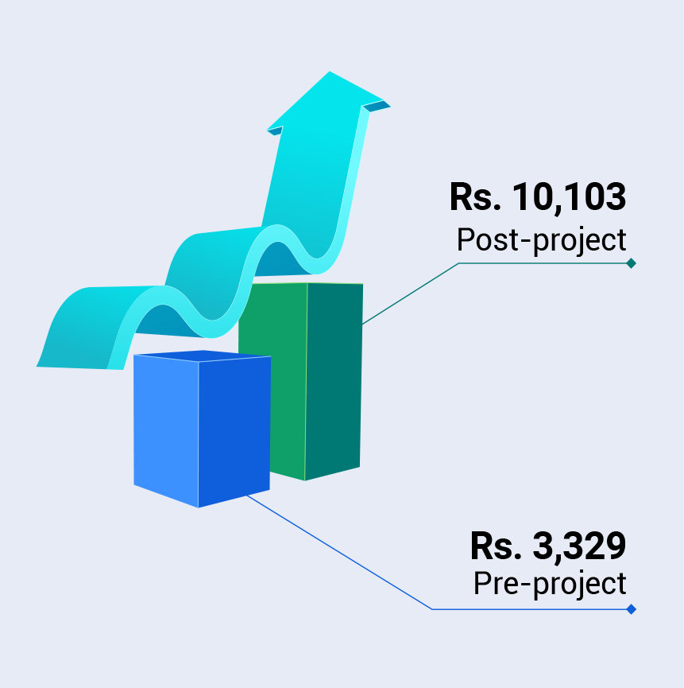
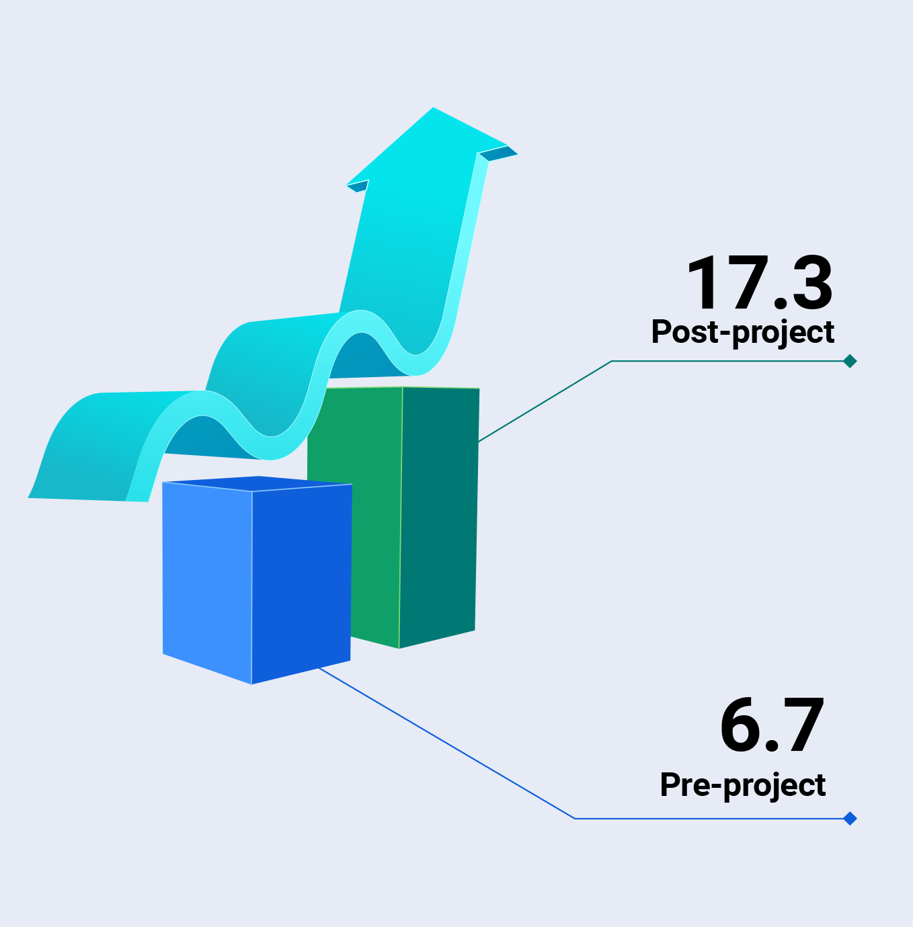
Honey Value Chain
Income from beekeeping
Change in harvest of honey
68% respondents sold honey in local markets, now exclusively sell to Honey Processing Unit/ SRC in Maldevta, Raipur.
Price increased, Rs. 497 per kg to Rs. 584 per kg.
203% increase in income over the baseline.
Increased income reduced financial dependency of women
Challenges in beekeeping : diseases/pest attacks (96%); lack of flora (77%). Hives are vulnerable to attacks by birds and bears, posing a challenge for protecting them from wild animal encounters.
158% growth in production compared to the baseline.
Use of machines for extraction, improved quality and quantity.
68% of surveyed beekeepers had prior experience in beekeeping, while 32% were newcomers.

Slide 20
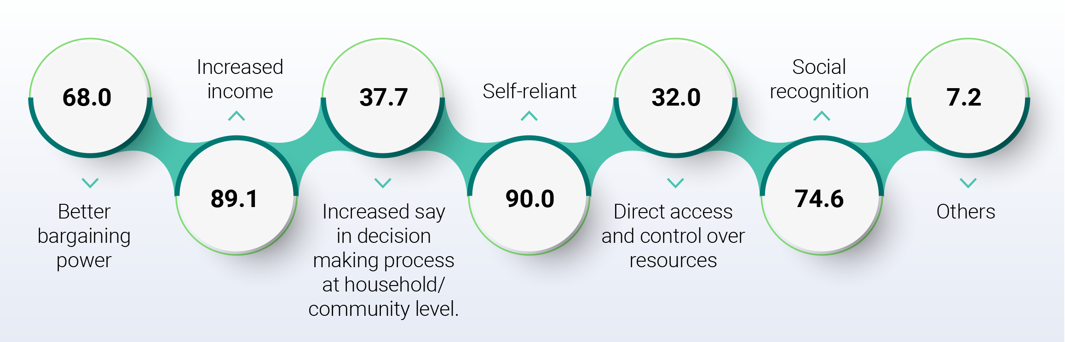

Institutional Support
Focus groups findings:
Joining collectives instilled confidence, leading to respect and recognition.
Women now play crucial roles in household decision-making.
Women feel justified in spending money on themselves due to contributing to family income.
Joining collectives provides a platform for meaningful conversations.
Overall benefits of being associated with collectives
"In the past, I would experience a tremendous sense of guilt whenever I bought something for myself from the market. However, now I firmly believe that since I contribute to the family income, it is acceptable for me to spend some money on myself. Joining the SHG has provided me with a platform to engage in meaningful conversations with other women, which was something I did not have before." – A woman FGD participant.
Additional significant changes reported as:

Slide 21
Institutional Support & Enterprises
Agri-based Enterprises
Cumulative turnover of all SRCs increased - Rs. 3.95 Cr. in 2018-19 to Rs. 9.9 Cr. in 2022-23, >150% growth.
Profitability ranging from 12.3% to 27.7%, is same period, in 2019-20 low due to the effects of Covid.
The growth rate of agri-produce was remarkable from 0.6% to 73% as evident

Slide 22
Promoting Individual Entrepreneurs
Distribution of entrepreneurs by enterprise type
Type of Enterprise | No. of Entrepreneurs
Agro processing units - (flour mill, rice mill, spice unit, oil expeller, etc.) | 14
Nurseries (aromatic herbs, vegetables, fruits, etc.) | 9
Processed food (pickle, juice, jam, etc.) | 6
Farm machinery- on custom hiring basis (power tiller, power weeder, threshers, etc.) | 7
High Value crops Demonstration fields- technical service provider | 7
Input suppliers/ shops- seed, etc. | 7
Beekeeping | 1
Floriculture | 1
Total | 52
Annual average income from enterprises
Income Level | % of Entrepreneurs
50,000-69,999 | 19.2
70,000-99,999 | 17.3
1,00,000-1,49,9999 | 40.4
>1,50,000 | 23.1

Slide 23
Change in Income
HH Average Annual Income
SN | Agri & Allied Value Chains/ Sources | HHs surveyed | Base line –Agri | Base line –All Sources | Endline- Crop Wise | Endline –various Value Chains | Endline –HH All Sources
 |  |  | Rs. | Rs. | Rs. | Rs. | Rs.
1 | Pulses | 168 | 12,000 | 68,000 | 41,923 | 38,159 | 1,12,852
2 | Millets | 78 |  |  | 37,346
3 | Cereals | 85 |  |  | 28,212
4 | Millets and Cereals | 163 |  |  | 32,583
5 | Pulses, Millets and Cereals | 269 |  |  | 38,888
6 | High Value Crops (Veg) | 152 |  |  | 37,635
7 | High Value Crops (Spices) | 57 |  |  | 39,702
8 | High Value Crops (Herbs) | 31 |  |  | 28,855
9 | High Value Crops (Veg, Spices & Herbs) | 192 |  |  | 37,266
10 | Seed Production | 97 |  |  |  | 11,520
11 | Beekeeping | 22 |  |  |  | 10,103
12 | Livestock/ Animal Husbandry | 299 |  |  |  | 20,598
13 | Others (Farm & Causal Labour, Services, Business, etc.) | 378 |  |  |  | 88,247
Combined av. HH income from all sources an increase of 65.9% over baseline.
The increase in income from agricultural VCs 218%.
Findings revealed that both yield & profitability of Rajma considerably high

Slide 24
Key Takeaways
Pulses and nutri-grain value chain
Vegetables, spices & aromatic herbs
Practices of line sowing & use of vertical nets has made kidney beans (Rajma) the most profitable pulse crop. This has led expansion of area and increase in number of farmers. Scaling up support for rajma and other pulses is recommended.
Scaling up millet cultivation. Millets have lower carbon footprints compared to rice and wheat. With the IYOM, HMS can play a vital role in creating awareness about the benefits of millets. Intercropping pulses with millets can sustain millet production, conserve soil and water, and optimize nutrient use.
Cultivating basmati rice in the hills is financially burdensome, leading to higher production costs compared to plains-grown rice. As a result, basmati rice from project locations has a higher price, which lowers consumer demand. Consumers often choose more affordable Punjab basmati rice. Himmotthan should shift its focus to other high-value crops.
Chilli cultivation can be profitable if Himmotthan addresses marketing hurdles.
Scaling up protected cultivation with poly houses offers significant benefits.
Introducing aromatic herbs in Duggada cluster, near beekeeping sites, was highly beneficial. These plants served as food for bees and generated additional income through flower sales. Considering the success, Himmotthan should expand aromatic herb cultivation to other locations.

Slide 25
Key Takeaways
Seed production
Farm Mechanisation
The promotion of seed villages is recommended
Crops like onion, potato, garlic, and coriander. This approach ensures the cultivation of high-quality seeds with superior characteristics, meeting the demand for quality seeds
Strategically alternating between onion seed production and bulb production in suitable areas.
Promoting the cultivation of long day garlic is crucial due to its high yield potential, especially in the Himalayan region.
Selection of planting material, maintenance of isolation for genetic purity, and adherence to recommended distances for cross-pollinated crops like onion are essential.
Monitoring adherence to recommendations related to climate, spacing, irrigation, fertilization, and weed management is also important.
To capitalize on government subsidies (up to 80% of market price) for farm equipment, a targeted approach should be adopted to scale up farm mechanization based on specific needs.
Himmotthan could enhance farm mechanization through partnerships with Krishi Vigyan Kendras (KVKs) to train farmers in selecting, operating, and maintaining farm machinery. This collaborative approach would empower farmers with the necessary knowledge and skills to effectively utilize and maintain modern agricultural equipment.

Slide 26
Key Takeaways
Critical Irrigation Support
Honey value chain
Institutional capacity for social enterprises
Pollen collection and bee venom extraction can be highly profitable. Pollen has a market value of Rs. 1200-2000 per kg, while bee venom can fetch prices ranging from Rs. 5000 to 15000 per gram. Bee venom is used in medical treatments and anti-aging creams, while pollen serves as a valuable health supplement.
SRC and CFC interventions, need capacity building support for sustainability.
An exit plan is necessary to ensure continuity and scalability through intensive support to SRC women.
Training – functional, financial literacy, leadership skills
The current supply of Trishulli products falls short despite significant demand. Challenges such as once-a-year collection from farmers, difficult terrain, extreme weather conditions, and long distances hinder the collection of produce from remote regions in Uttarakhand.
At the CFC level, farmers prefer selling their produce to local buyers despite better rates offered by Trishulii.
To increase turnover, Trishulii requires improved working capital.
Explore better marketing channels to establish Trishulli as a recognized business entity.
Additional efforts needed to enhance production, scale, and volume, promoting Trishulii as a brand and developing a sustainable social enterprise.
Himmotthan has made efforts to provide irrigation support to farming households/groups. However, intensifying this support further would greatly enhance productivity and farmer outcomes.

Slide 27
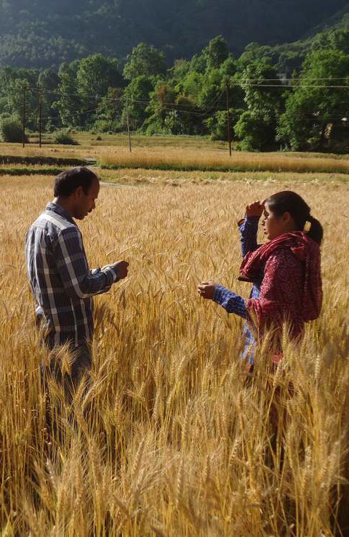
Conclusions
Implementing multiple linked projects had a significant impact on the community. The interventions focused on irrigation, farm mechanization, and seed production, such as onion, garlic, and coriander, have greatly benefited community by increasing productivity, incomes, and food security.
Despite the success of these interventions, formation of social capital remains a weak area that requires more attention and effort. This aspect is crucial for the sustainability. It is important to address this issue to ensure the long-term success and impact of the project.
It is recommended to evaluate & prioritize the various interventions that have resulted in the most significant changes. This would help optimize limited resources & energies of team and focus on interventions that yield the best outcomes and impacts for each stakeholder community.
Overall, combination of multiple linked projects had a positive effect on the community, but addressing social capital formation and streamlining interventions will be essential for maximizing the project's effectiveness and sustainability.

Slide 28
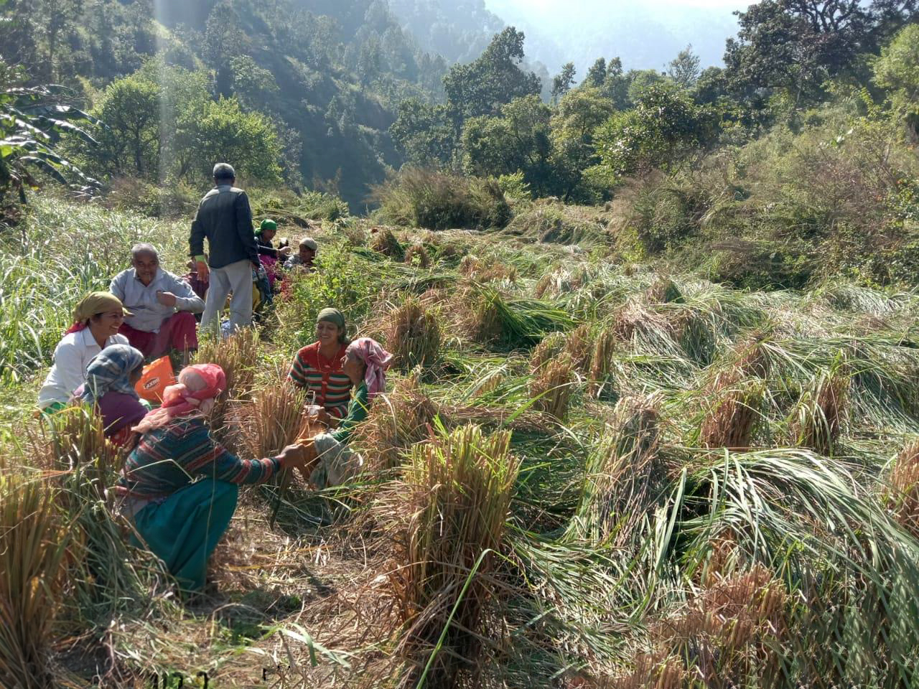
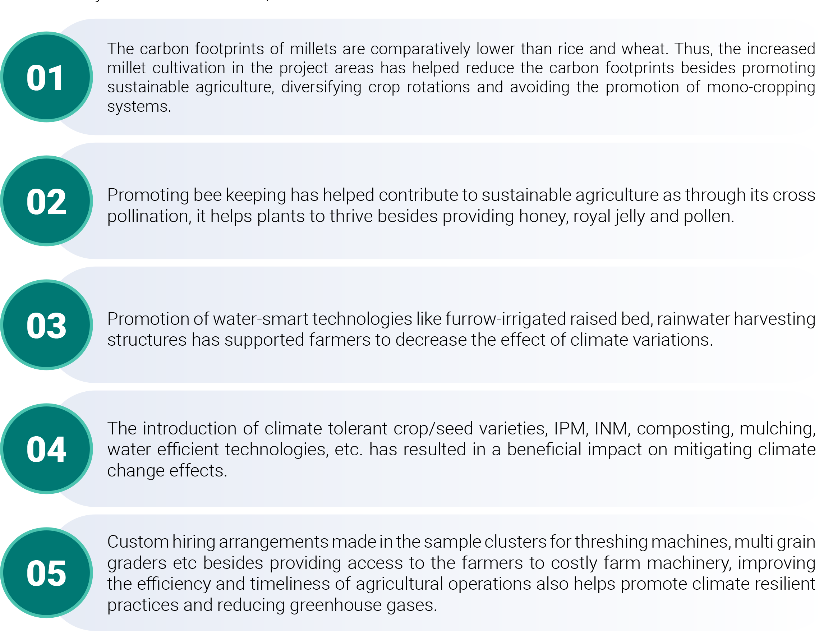
Mitigating Climate Change Effects on Farming: Beneficial Impacts

Slide 29
Post-harvest Management Practices
Intervention Support
01
Training and Promotion of Post-Harvest Technologies:
Farmers and producer groups were trained on post-harvest processes.
Technologies such as threshing, drying, cleaning, sorting, and grading were promoted.
Farmers receive training on harvest timing and criteria for grading and sorting at the farm level. They are taught to segregate produce based on quality, shape, and color.
02
03
Introduction of Threshing Machines:
Threshing machines were introduced in the clusters to improve efficiency.
Multi-grain graders were promoted for grading pulses and other agricultural produce.
Establishment of Semi-Processing and Milling Units:
Semi-processing and milling units were set up at the cluster level.
These units aimed to add value to the agricultural produce.
04
05
06
Centralized Processing Unit:
A centralized processing unit called Trishulii was established in Dehradun.
The final product from the clusters was transported to Trishulii.
Trishulii handled packing, branding, and marketing of the products.
Fund Mobilization:
Funds were mobilized from banks to cooperatives, Trishulii, and groups.
Unused funds from Self-Help Groups (SHGs) were utilized for promoting enterprises at the cluster level and Trishulii.
Marketing Channels:
The graded, packed, and branded products were marketed through various channels.
These channels included bulk/wholesale buyers, retailers, and online platforms.

Slide 30
Demographics
Gender & age-group
Literacy level
Caste category
Occupation
Migration
The sample had a high proportion of women-headed households (37%) and women respondents (74%) due to the preference given to females during the endline survey, as most males were unavailable during the day.
The age distribution was mainly concentrated in the 31-45 years age group (43%), followed by 28% in the 46-60 years age group.
Illiterates constituted 18% of the sample. Among the literate respondents, the majority (18%) had completed their Higher Secondary education, followed by 17% who had studied up to 8th grade. Those with a Secondary education represented 13% of the sample, and approximately 10% were Graduates.
The majority of the sample belonged to the General caste (71%), while OBCs constituted 26%. About 52% of the households were classified as below the poverty line (BPL).
Agriculture (crop husbandry) was the primary source of income for approximately 80% of the households. Those dependent on labor work (both farm and non-farm) accounted for 9% of the sample, while 6% earned their primary income from government or private jobs.
Livestock rearing served as the secondary source of income for 55% of households, followed by agriculture (19%). Around 19% and 12% of respondents worked as casual laborers and agricultural laborers, respectively, for earning their secondary income.
Outmigration for employment increased from 16% to 23%, while the proportion of families migrating together decreased from 12% to 10%. Male migrants constituted the majority.
Before the project, households earned an average of Rs. 17,333 per month through permanent migration and Rs. 11,649 per month through seasonal migration. After the project, the average income from permanent migration decreased to Rs. 16,461 per month, while seasonal migration increased to Rs. 13,580 per month.

Slide 31
Social Impacts
01
02
03
04
05
Benefits of women's collectives
Transformation and empowerment
Recognition and respect
Personal success story
Farmer empowerment
Connecting women to collectives provided financial security, self-reliance, and increased influence in decision-making. Collectives served as platforms to address various issues and offered savings and hassle-free loans.
Women experienced increased confidence, poise, & self-worth through income-generating activities, exposure visits, & collective strengthening. They became more outgoing & developed awareness of seed varieties & crop practices.
Association with collectives led to increased respect within families and communities. Women's contribution to household income was recognized, and men's perception of women and collectives changed.
A participant shared significant economic and social improvement since joining a collective, investing in her children's future, and being elected as the Sarpanch of her village.
Farmers gained training on improved agricultural techniques through exposure visits, enabling them to enhance productivity and income. They now serve as mentors, supporting other farmers to positively impact their lives.

Slide 32
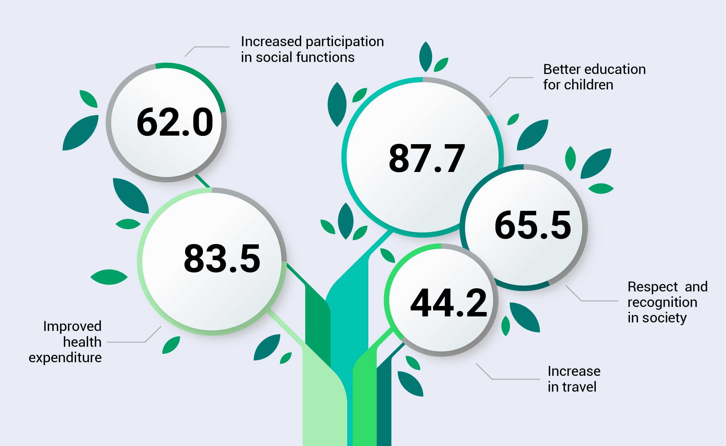
Other Impacts (Improvement in education, health, nutrition, etc.)
Women in focus groups expressed satisfaction that a portion of their earnings covers daily household expenses.
Increased income from onion production enabled parents to send their children for higher education. Additional earnings were also used to renovate houses, improving quality of life and asset ownership.
Income increase improved households' nutrition and food security. Food security for respondents increased after the intervention, and over 90% reported an improvement in their diet. Vegetable cultivation provided sufficient green vegetables, and livestock intervention increased milk production, meeting nutritional needs.

Slide 33

THANKS!

